Slide 1

PRESENTATION ON TECHIFYINDIA ORGANIZATION
maiboobsab nadaf 393CS20009

Slide 2
CONTENTS
Overview of organization
Vision and mission of the organization
Organization structure
Roles and Responsibilities of personnel in the organization
Products and market performance
CONCLUSION

Slide 3
Overview of the Organization:
TechifyIndia is a start-up for providing IT solutions, building innovative IoT products providing systems integration solutions and technology provider
Since 2017, the company have been providing service like:(website development, design services, IoT, application development and technical support) to clients in various industries
Our creative team brings business to the next level of digitalization with mobile apps and internet marketing to improve branding and lead generation to succeed.

Slide 4

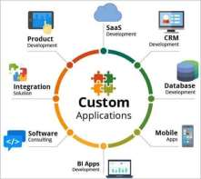



What Techify India do?
Customized-Software’s
Mobile-Applications
Web-Design
AI/ML Projects

Slide 5
Vision and mission of the organization:
To produce excellent services in the field of IT Services
The company's vision and mission is creating a positive impact on the industry and society

Slide 6
Organization structure:
The executive team consists of 12 members, with the CEO being the highest-ranking member of the organization.
The organization's structure ensures that each department operates efficiently and effectively while working towards the company's goals.

Slide 7
Roles and Responsibilities of personnel in the organization:
The roles and responsibilities of personnel within the organization vary depending on their job functions and departmental affiliations.
the common roles within the organization include
CEO, Marketing management, Developers, H-R management, etc,

Slide 8
Products and market performance:
TECHIFYINDIA Software Solution’s strength lies in understanding the client’s business processes, culture, vision and goals across the industry segments and offering client oriented solutions which are highly reliable, creating customer comfort. Few of our products are listed below.
Cashew Soft ERP
TAX-E(GST Billing)
CNC Monitoring
IOT Based Smart Bell, etc

Slide 9
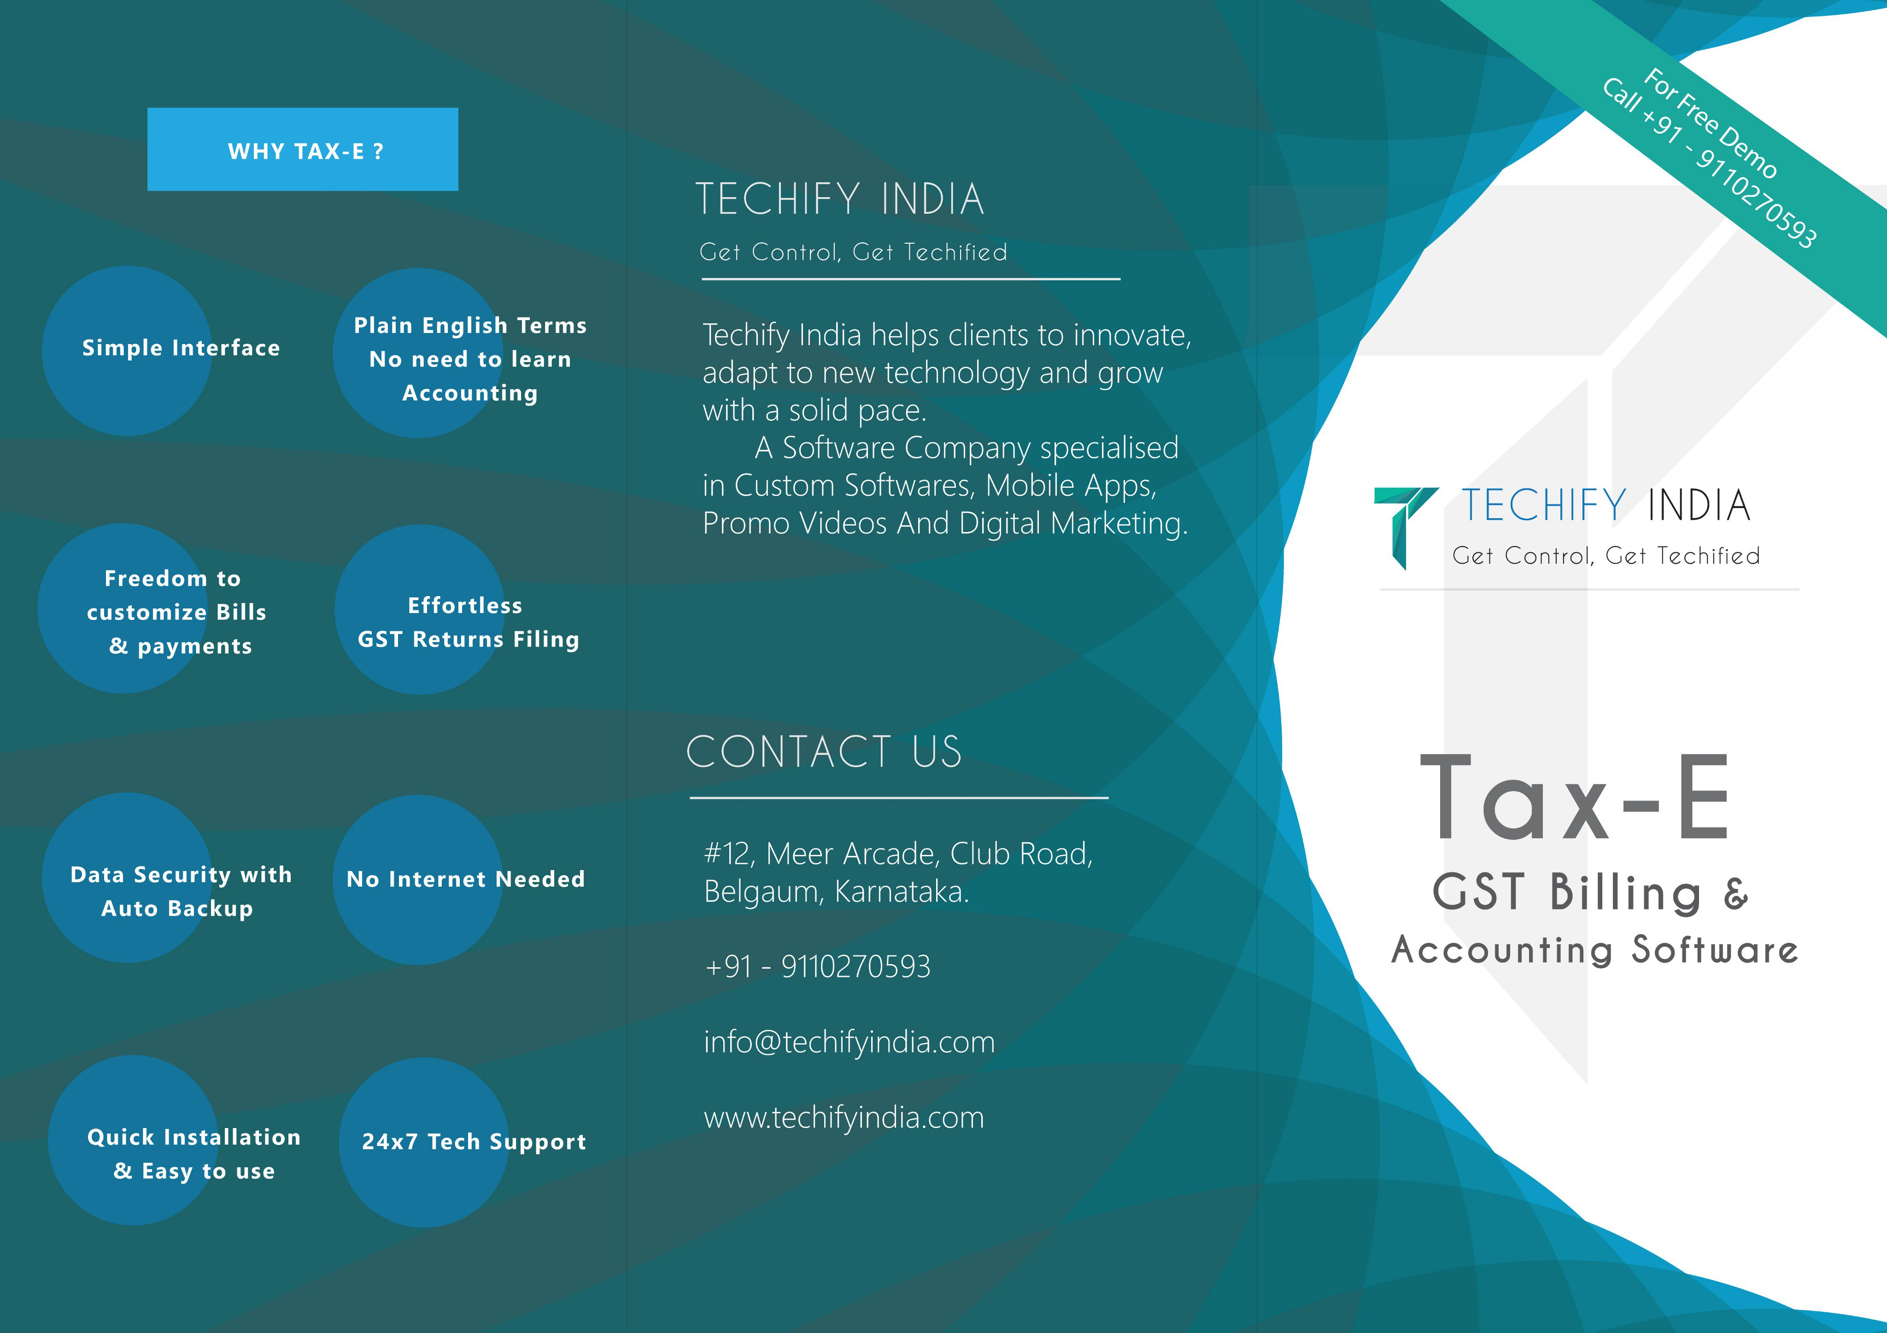
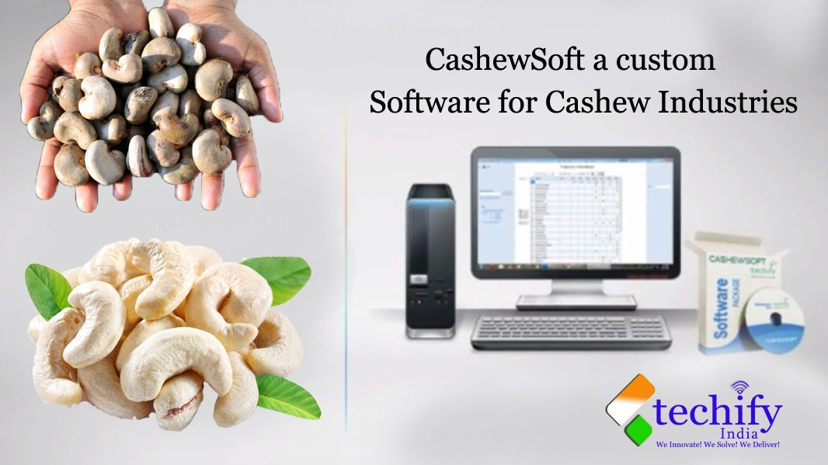

Slide 10





Slide 14
CONCLUSION
In conclusion, I hope that this presentation has given you a clear understanding of our company and the value that we can bring to your business.
We believe that by working together, we can achieve great success and create a long-lasting partnership. We are committed to earning your trust and delivering results that exceed your expectations.
Thank you for your time and consideration, and we look forward to the opportunity to work with you.

Slide 15
Thank You

